Slide 1
Supervisor Training Guide
PRESENTER
Linda Lambur, NCGA Yield Contest Manager

Slide 2
Welcome
The Yield Contest has been recognized for its integrity and credibility which is due, in large part, to the network of supervisors who verify the accuracy of yields submitted for competition.
As a supervisor, your attention to detail will contribute to the success of the contest. This presentation has been created to help you perform this task.

Slide 3
Supervisor Qualifications
NCGA will approve supervisors active or retired from any of the following positions:
FFA Advisor
Vocational Agricultural Instructor
County Extension Agent or Assistant
(NRCS) Natural Resources Conservation Service Employees
(FSA) Farm Service Agency CED/Loan Manager/Officer
(SWCD) Soil & Water Conservation District
Farm Credit Services Officer
Bank Ag Loan Officer
Private Crop Consultant or Agronomist not employed by a seed company
College of Agriculture Instructor
American Society of Farm Managers Accredited Farm Manager
Crop Insurance Agent/Adjustor
NCGA Corn Board Member and State Board Members
State Corn Association Staff
Supervisor profile must be loaded in the contest database to be available to select to add to an entry. Profile consists of name, address, business, job title, phone number and email address.

Slide 4
Supervisor Disqualifications
Anyone that has a financial or direct business tie to a company that sells agribusiness supplies, such as deed or chemical reps or farm equipment sales.
An employee or relative of the contest entrant.
The contest entrant.

Slide 5
Field Requirements – Pre-Harvest Inspection
The contest plot must be 10 continuous acres of the same hybrid brand and hybrid number and may be any shape.
Supervisor must inspect the field conditions to determine that tillage practice meets the class qualification.
All end rows/turning rows and the equal number of outermost rows on each side of the field cannot be a part of the harvested area.
Have the operator run the combine and transfer auger empty to ensure there is no corn present prior to harvesting the contest plot.
Check and confirm all trucks are empty prior to harvesting the contest plot.

Slide 6
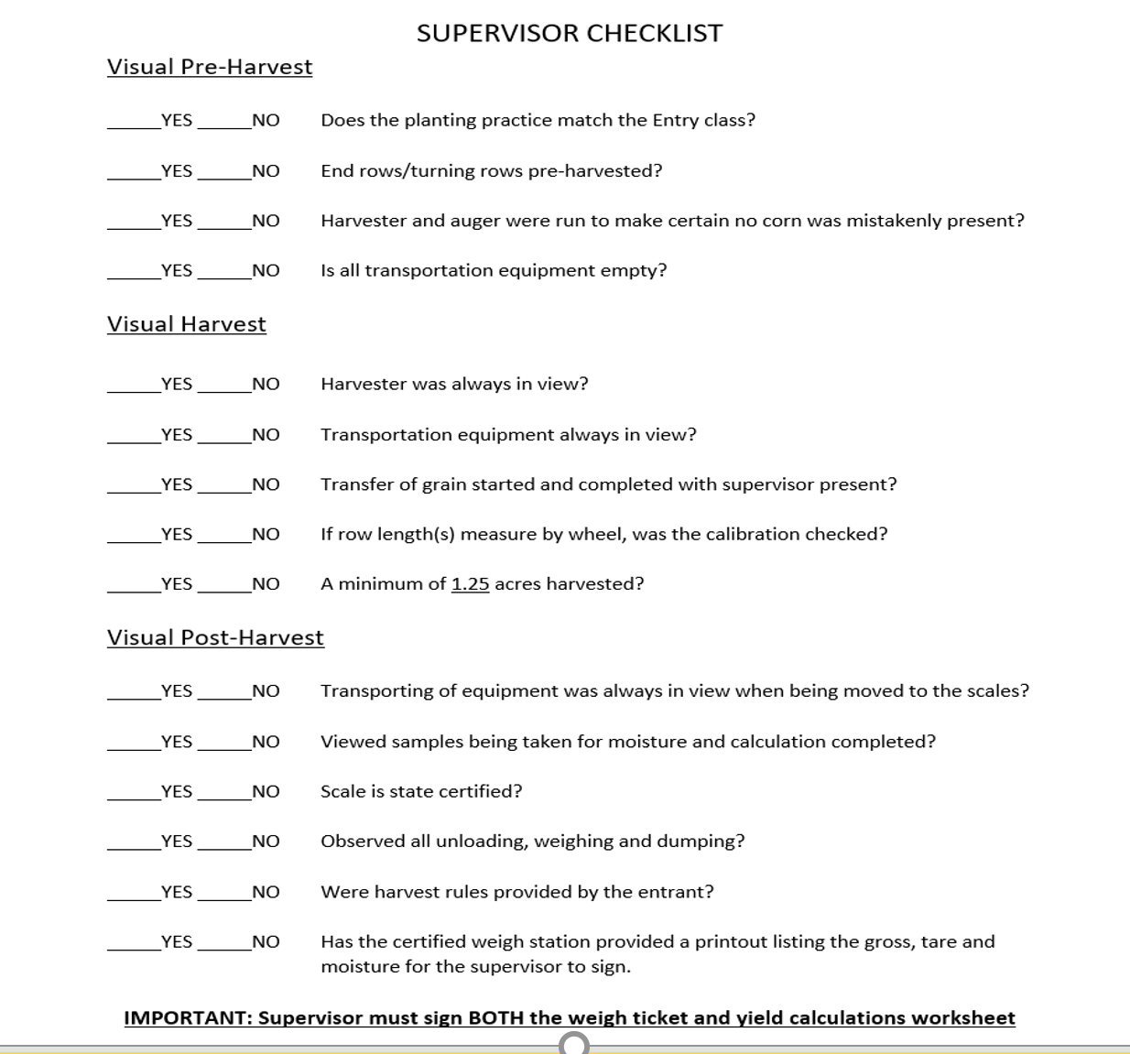
Supervisor Checklist
Printable checklist .pdf is available on the contest web page www.ncga.com/yield-contest

Slide 7
Measuring
The contest plot being harvested must be measured to determine its area. All measurements must be made with one of the following:
Tape
Chain
Measuring wheel - Confirm the wheel is calibrated! The measuring wheel can only be used when walking it.
Laser (Only on straight & flat fields)
GPS systems ARE NOT accepted as a measuring devise

Slide 8
Supervisor must be present during:
Harvesting – length of each pass and number of rows harvested documented by the supervisor (Acreage Harvest Worksheet). Tape
Transporting
Weighing – supervisor must sign the weigh ticket that details the gross, tare and moisture readings of the contest plot. The Acreage Harvest Worksheet must also contain the supervisor’s signature.
Laser (Only on straight & flat fields)
*The supervisor is responsible for recording all computations and field measurements

Slide 9
Harvesting the Contest Plot
Harvest 1.25 acres or more with one supervisor present to sign all required documents. If the harvest yields 350.000 bu/ac or greater, a recheck is required with two supervisors present to both sign both recheck documents.
Harvest pattern example:
Four-row harvester: Harvest four rows, skip twelve, harvest four, skip twelve, repeat as needed
Six-row harvester: Harvest six rows, skip eighteen, harvest six, skip eighteen, repeat as needed
Eight-row harvester: Harvest eight rows, skip twenty-four, harvest eight, skip twenty-four, repeat as needed

Slide 10
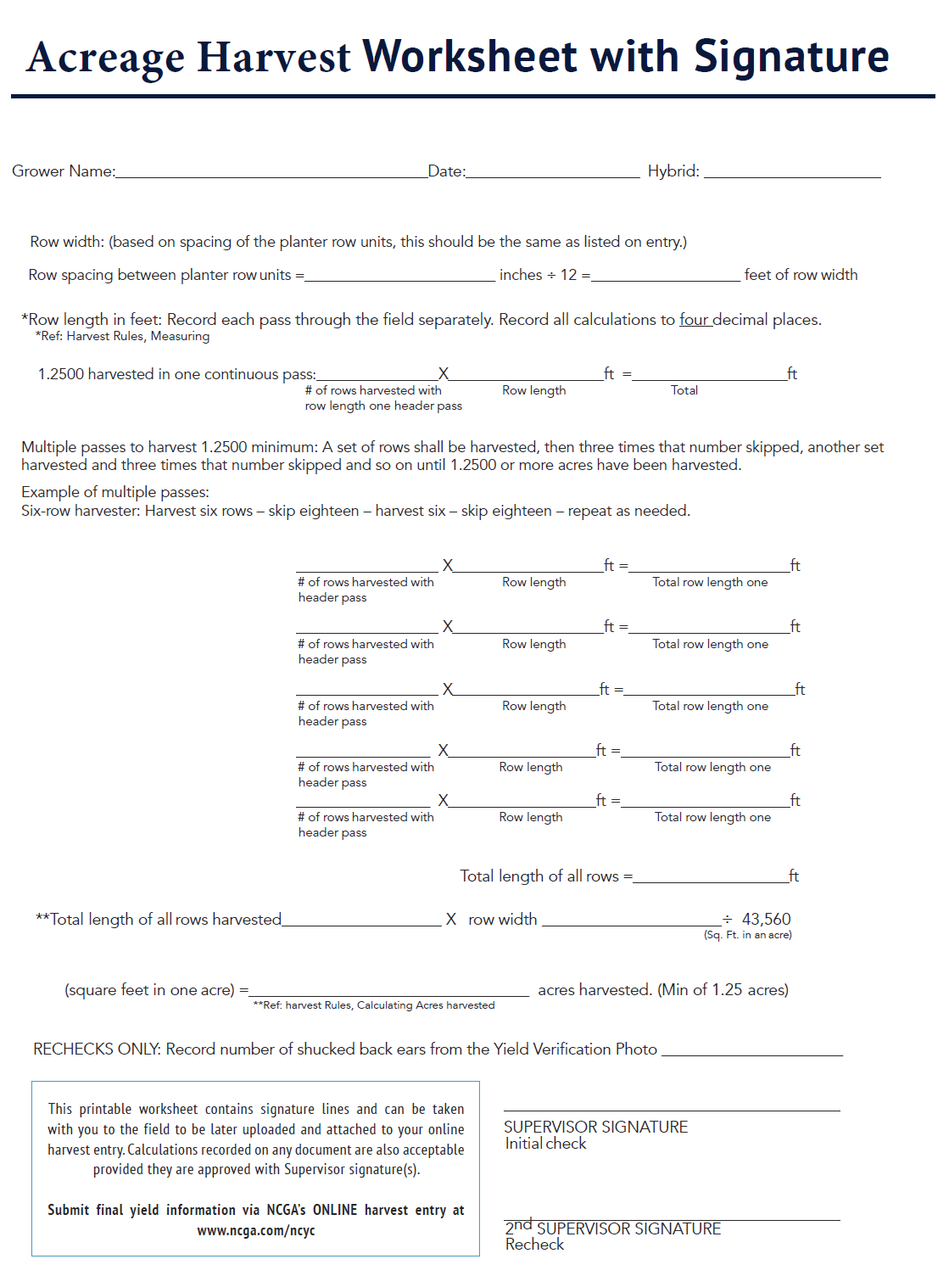
Acreage Harvest Worksheet with Signature
Printable Acreage Harvest Worksheet with Signature .pdf is available on the contest web page www.ncga.com/yield-contest

Slide 11
Calculating the Yield
Row length
Row width (spacing between planter rows)
Number of rows harvested in one header pass
Square feet in one acre (43,560)
Moisture Percentage (no hand-held moisture readers allowed)
Harvest calculations must be carried out to four decimal places!

Slide 12
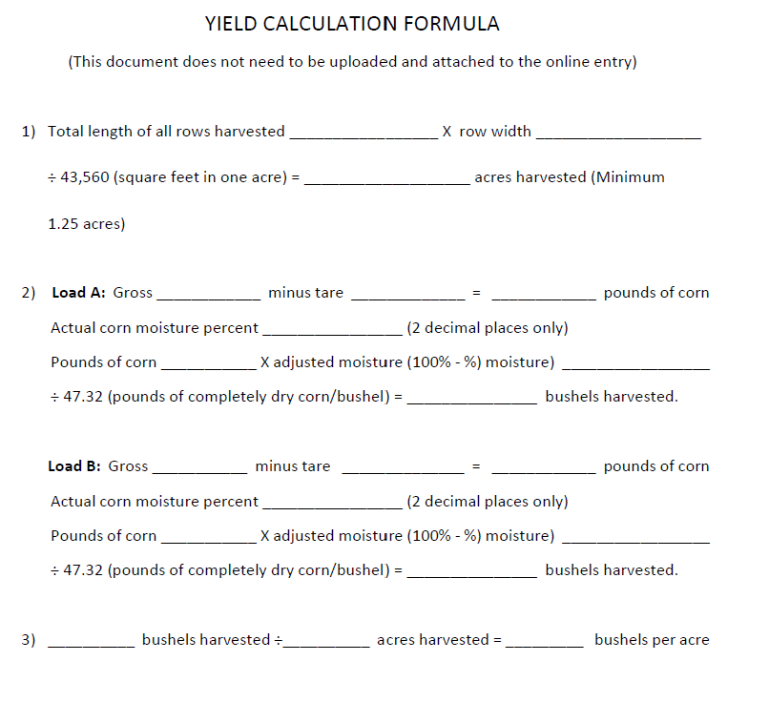
Calculating the Yield
Printable Yield Calculation Formula .pdf is available on the contest web page www.ncga.com/yield-contest

Slide 13
Moisture Testing
No hand-held moister testers are allowed. An entry will be disqualified if a hand-held moisture tester is used. A State certified testing device for corn at a grain handling facility may be used or a tabletop tester located on the farm or at a grain handling facility may be used. Supervisor(s) must be present during the representative sample of corn through the weighing and moisture testing process so they can then sign the weigh tickets to verify the gross, tare and moisture. The supervisor(s) must sign off on the printed moisture reading or the hand-written moisture readings if a printout is not available.

Slide 14
Online Entry of the Harvest
The supervisor, grower or sales rep may complete the online harvest entry. Whoever will be submitting must have copy of the harvest documents to be available to upload and attach to the online entry.
The confirmation copies are stored on the grower’s profile page throughout the contest. It is recommended you also retain a copy for your records.
NEED A RECHECK? Did the first check yield 350.0000 bushels or greater? If so, a recheck must be performed.

Slide 15
Harvesting the Recheck
TWO SUPERVISORS MUST BE PRESENT TO HARVEST A RECHECK IF THE FIRST HARVEST YIELDS 350.0000 OR GREATER!
First a photo must be taken of a 36” length of the recheck plot (see the next slide for photo instructions) prior to harvesting it.
IMPORTANT – It is mandatory to contact NCGA to report all initial yield results exceeding 350.0000 bushes per acre and again to report the recheck yield results. Failure to report the high yields will result in disqualification.
Begin the recheck harvest in the rows next to the first harvest and continue harvest pattern until the required 1.25 bu/ac or more have been harvested.
The yield worksheet containing the number of rows on the header platform and the length of each pass must be recorded by the supervisor and signed by both supervisors on the recheck plot.
The yield worksheets, weigh tickets and photo will be uploaded and attached to the online harvest entry after the data has been manually input on the entry form.

Slide 16
Photo Illustration Guide
Photo must be a 3-ft. sample section of the recheck rows to be harvested - NO outside rows
Straight shot picture of the two supervisors holding either end of a yardstick at corn ear level
Ears in the photo of the recheck plot stand must be shucked back
Cut the stalks off above the shucked back ears
If twin row corn is planted, both rows must be shucked back
Photo to contain one diameter of a broken ear taken next to the 36” parameter of the photo being taken to capture image of the kernel depth
Supervisors’ faces must be visible
36” length of the tape measure may be used if yard stick unavailable
Supervisor must count and record the number of ears captured in the 36” photo and note it on the Acreage Harvest Worksheet
Photo will be submitted in the online program as an attachment when submitting the recheck yield
Remember to contact NCGA to report the first check yield of 350.0000 or greater and text photo to 636-675-3562, and also report the recheck yield if 350.0000 or greater.

Slide 17
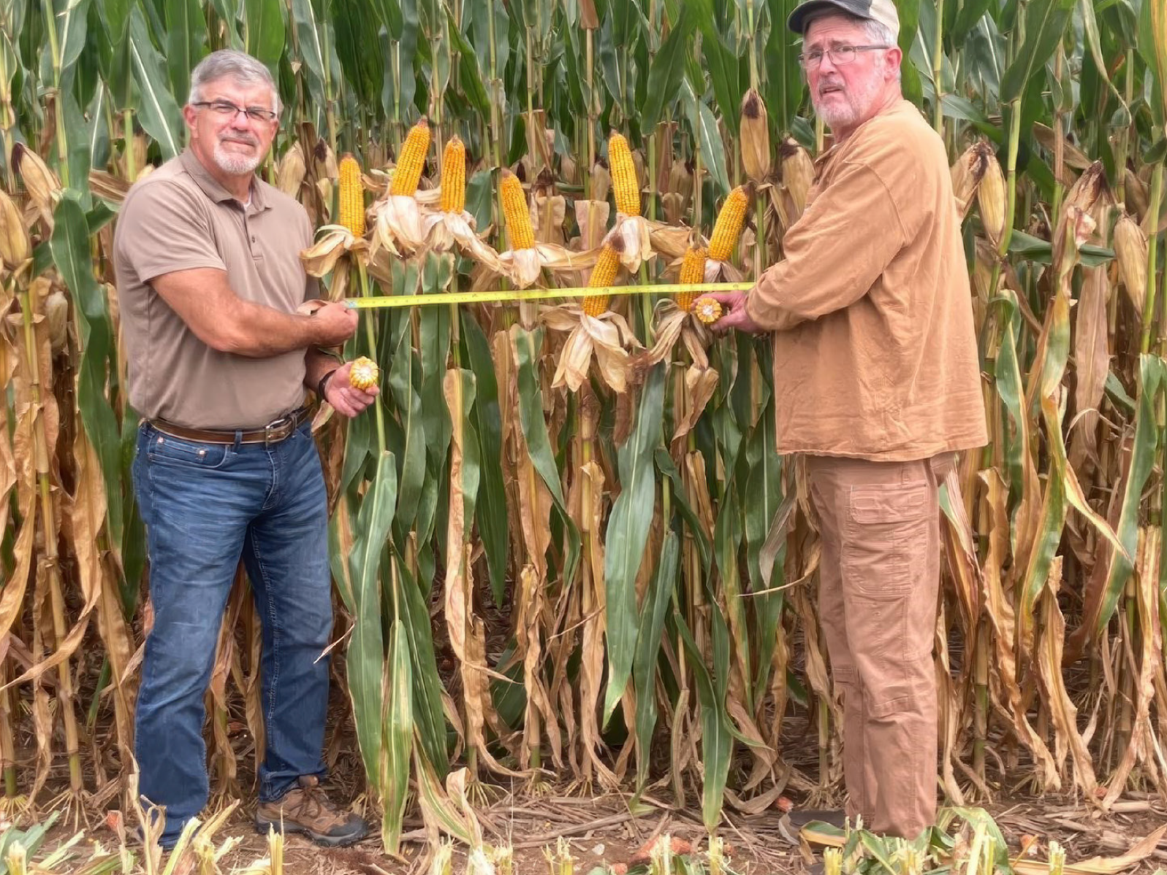
Photo Illustration of the Recheck Plot

Slide 18
Thank you for helping our member growers!
If you have any questions along the way, please contact NCGA
  Email: yieldcontest@ncga.com
  Phone: 636-733-5512

