Slide 1
Welcome to the National Corn Yield Contest Supervisor Guide

Slide 2
Welcome to the National Corn Yield Contest Supervisor Guide
The National Corn Yield Contest (NCYC) has been recognized for its integrity and credibility which is due, in large part, to the network of supervisors who verify the accuracy of yields submitted for competition.
As a supervisor, your attention to detail will contribute to the success of the contest. This presentation has been created to help you perform this task.

Slide 3
Supervisor Qualifications
Be certain that you meet the qualification requirements as found on page 10 in the Rules Book. Your contact information must be populated in the online supervisor database so the entrant can select you on their online entry.
Familiarize yourself with the Entry & Harvest Rules. Copy located on our contest web page www.ncga.com/ncyc
*Questions or concerns please contact NCGA: 636-733-5512

Slide 4
Field Requirements – Pre-Harvest Inspection
The contest plot must be 10 continuous acres of the same hybrid brand and hybrid number and may be any shape.
Supervisor must inspect the field conditions to determine that tillage practice meets the class qualification.
All end rows/turning rows and the equal number of outermost rows on each side of the field cannot be a part of the harvested area.
Have the operator run the combine and transfer auger empty to ensure there is no corn present prior to harvesting the contest plot.
Check and confirm all trucks are empty prior to harvesting the contest plot.

Slide 5
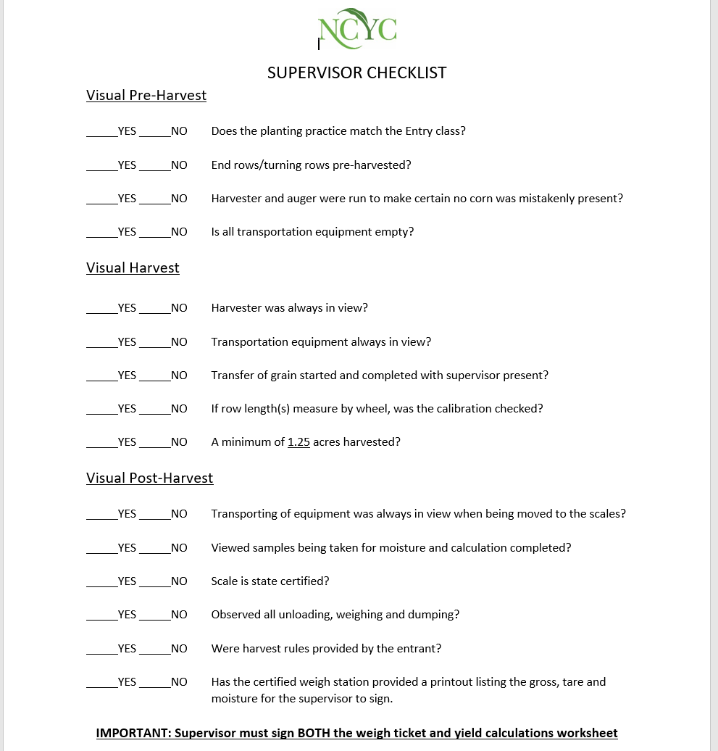

Slide 6
Measuring
The plot being harvested must be measured to determine its area. All measurements must be made with one of the following:
Tape
Chain
Measuring wheel - Confirm the wheel is calibrated! The measuring wheel can only be used when walking it.
Laser (Only on straight & flat fields)
*GPS systems ARE NOT accepted as a measuring devise

Slide 7
Supervisors must be present during:
Harvesting – length of each pass and number of rows harvested documented by the supervisor containing supervisor’s signature
Transporting
Weighing – supervisor must sign the weight ticket containing the gross, tare and moisture readings of the contest plot
*The supervisor is responsible for recording all computations and field measurements.

Slide 8
Harvesting the Plot
Harvest 1.25 acres or more with one supervisor present to sign all required documents. If the harvest yields 325.000 bu/ac or greater, a recheck is required with two supervisors present to both sign off on the recheck documents.
Harvest pattern example:
Four-row harvester Harvest four rows, skip twelve, harvest four, skip twelve, repeat as needed
Six-row harvester Harvest six rows, skip eighteen, harvest six, skip eighteen, repeat as needed
Eight-row harvester Harvest eight rows, skip twenty-four, harvest eight, skip twenty-four, repeat as needed

Slide 9
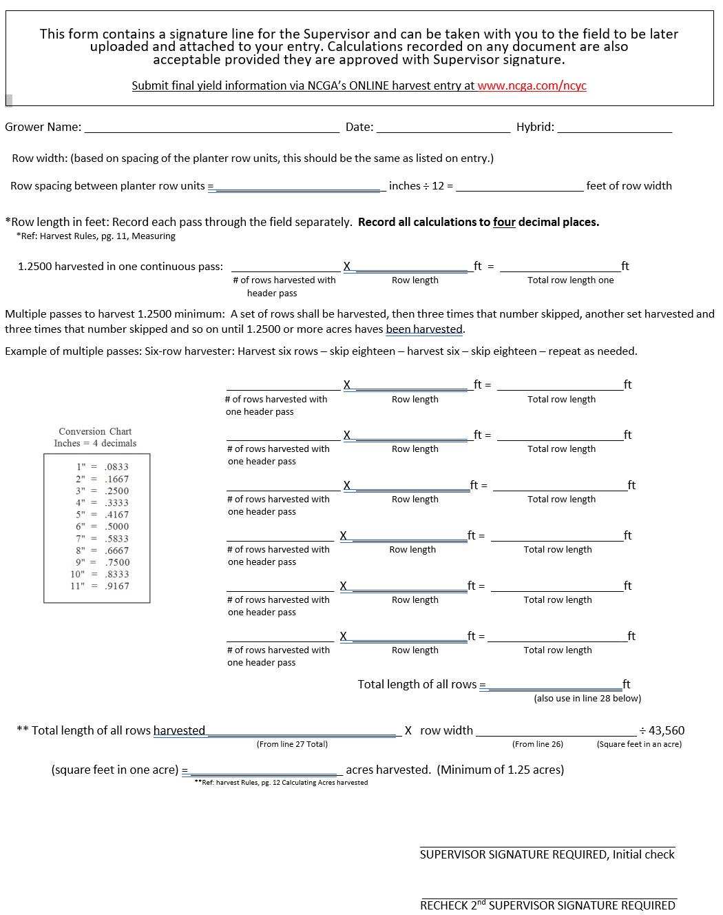

Slide 10
Calculating Yield Requirements
Row length
Row width (spacing between planter rows)
Number of rows harvested in one header pass
Square feet in one acre (43,560)
Moisture Percentage
Harvest calculations must be carried out to four decimal places!

Slide 11
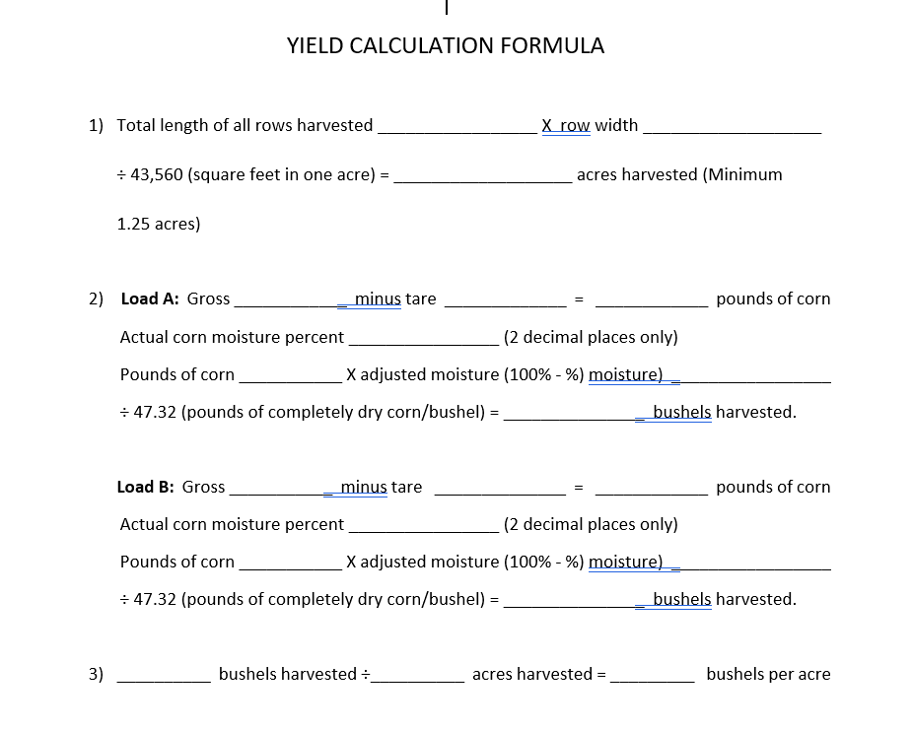

Slide 12
Moisture testing
No hand-held moister testers are allowed. An entry will be disqualified if a hand-held moisture tester is used. A State certified testing device for corn at a grain handling facility may be used or a tabletop tester located on the farm or at a grain handling facility may be used. Supervisor(s) must be present during the representative sample of corn through the weighing and moisture testing process so they can then sign the weigh tickets to verify the gross, tare and moisture. The supervisor(s) must sign off on the printed moisture reading or the hand-written moisture readings if a printout is not available.

Slide 13
Harvesting the ReCheck
The supervisor signed yield the worksheet containing the number of rows on the header platform and the length of each pass must be recorded by the supervisor.
The supervisor must sign the weigh ticket containing the gross, tare and moisture of the harvested plot.
Both the yield worksheet and weigh ticket must be uploaded and attached to the online harvest entry after the data has been manually input onto the entry.

Slide 14
Entering the Harvest
If the plot yields 325bu/ac or great, a recheck is required.
Begin the recheck harvest in the rows next to the first harvest.
Continue harvest pattern until the required 1.25 bu/ac or more have been harvested
Important – Any yield over 325.0000 bushels/acre yields requires a call to NCGA office to report the yields – first check and recheck - or the entry will be forfeited.
A supervisor, grower or sales rep may input the harvest data on the online entry. Whoever will be submitting must to have copy of the harvest documents to be able to upload and attach to the online document for verification.

Slide 15
On behalf of NCGA and the National Corn Yield Contest
Thank you!

